Slide 1

Tel: 07711 443 463
E-mail: info@safeguardingfirst.com
Website www.safeguardingfirst.com
Pam Gartland:Safeguarding First ‘App’
Available for both iPhone and Android

Slide 2
Safeguarding Children
Vulnerable Adults
Safe People
Our responsibilities to Safeguarding in schools and settings
Safe Premises & Places
Safe Children

Slide 3
Agenda
Responsibilities for staff
Peer on Peer abuse
Online behaviours
Child J Serious Case Review
What can we do at school and home
Breck Bednar and case study
Recognising Vulnerability

Slide 4
Our Responsibilities
All school and college staff have a responsibility to provide a safe environment in which children can learn.
‘Governing bodies, proprietors and school or college leaders should ensure the child’s wishes and feelings are taken into account when determining what action to take and what services to provide. Systems should be in place for children to express their views and give feedback. Ultimately, any system and processes should operate with the best interests of the child at their heart.’
(KCSIE, 2016)

Slide 5
Sexual Harassment in Schools
Dismissed as Banter
Schools are failing to take the sexual harassment of girls seriously and too often dismiss it as ‘banter, according to a committee of MPs. According to their report, 59% of girls aged 13-21 said they had been sexually harassed at school. MPs say the DfE and Ofsted lack a plan to tackle the issue.
Keeping Children Safe in Education 2016 asks all schools to have a Peer on Peer Abuse Policy shared with all staff to manage these circumstances effectively.

Slide 6
Sexual Harassment in Schools continued
The Stop It Now campaign, a project working against child sexual abuse and run by the Lucy Faithful Foundation, has produced guidance on preventing abuse among children and young people. It features advice on healthy sexual development, and age-appropriate sexual behaviour
http://www.stopitnow.org.uk/the_lucy_faithfull_foundation.htm

Slide 7
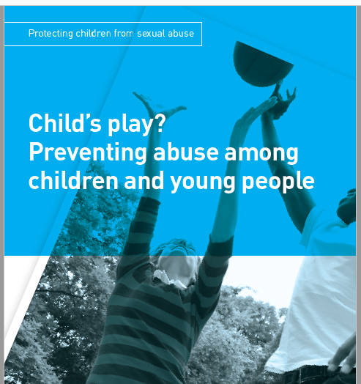

Slide 8
Self Esteem, Self Harm and
Issues of Cyberbullying
The UK has ranked 13th out of 16 countries for children’s ‘life satisfaction’ (above South Korea, Nepal and Ethopia).
Last year Childline was called by a child every 30 minutes having suicidal thoughts.
Childline counselled 4,541 children last year (up by 13%).
Counselling for online bullying has increased by 88% in 5 years.
Children aged 5-15 are spending 3 hours per day on the internet and Youtube is taking ‘centre stage in children’s lives’. (Childwise)

Slide 9
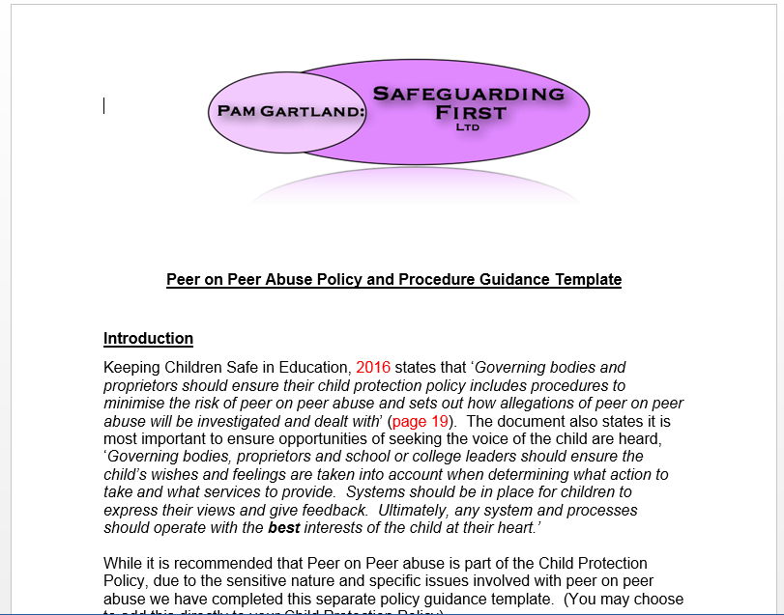
SF: Peer on Peer Abuse Policy and Guidance

Slide 10
The Policy
Can be embedded in your CP policy.
Covers areas of KCSIE 2016.
Covers types of peer on peer abuse.
Gives direction on dealing with incidents.
Considers informing parents, after care and preventative strategies.

Slide 11
Online Behaviours

Slide 12
Changes in Children’s
Media Consumption
55% of 3-4 year olds have a tablet (up from 54% in 2015, 39% in 2014).
4 in 10 or 41% of 5-15 year olds own a smartphone.
The numbers of children watching TV has decreased.
The favourite social media site for children is any type of group chat: Facebook messenger, WhatsApp and Instagram.
YouTube is the favourite destination on tablets and mobile phones.
Children and Parents: Media Use and attitudes report 2016

Slide 13
What Are The Risks Online?
Grooming
Child Sexual Exploitation
Cyberbullying
Trolling
Radicalisation
Access to inappropriate material
Spending money on gaming sites

Slide 14
Barnardo’s Survey on Online Grooming
Taken from 5 of Barnardo’s services for children who are sexually exploited.
42% of the 702 children supported in the last six months had been groomed online.
Of these, 61% met the perpetrator and were sexually exploited.
Almost half of children groomed online were exploited by more than one perpetrator.
http://www.barnardos.org.uk/publication-view.jsp?pid=PUB-2920
December 2016

Slide 15
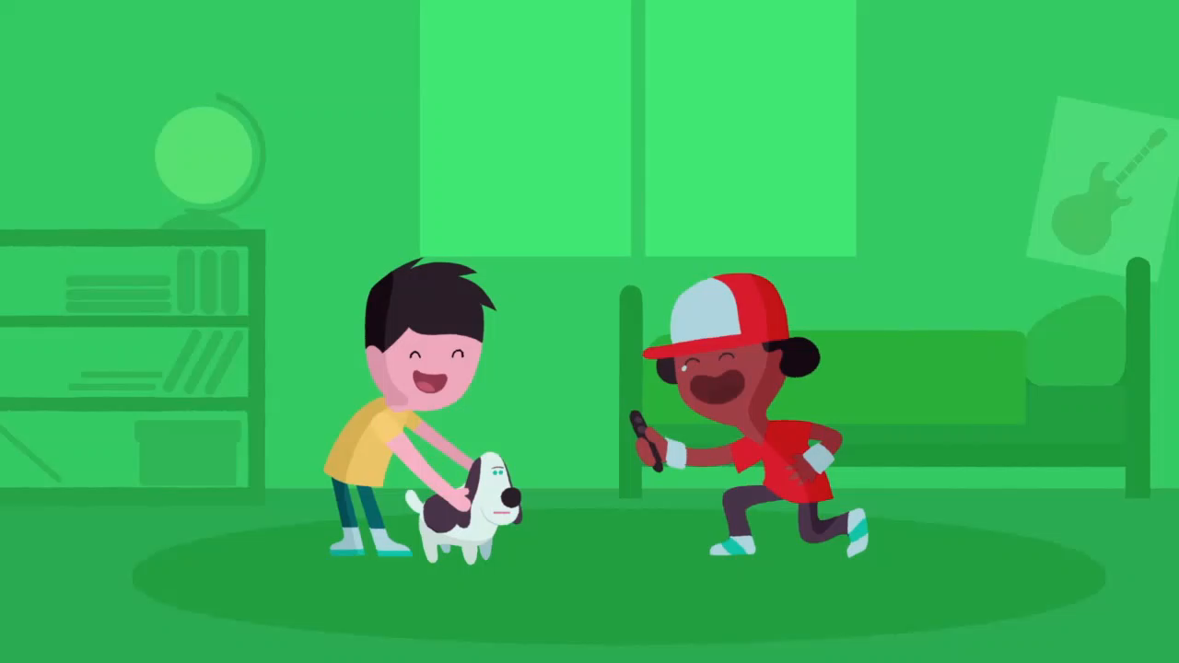
‘I saw your willy’ NSPCC

Slide 16

‘Lucy and the boy’ NSPCC Share Aware

Slide 17
What Makes Children More at Risk?
Vulnerability
Naivety
Isolated or excluded
Unable to communicate in reality
Low Self esteem or confidence
Lack of understanding of risk
Seeking an alternative life / thrill seekers
Severe Neglect
Disaffected or disassociated with society
Previous life experience
Cry for help
Lack of boundaries/strict boundaries
Peer pressure

Slide 18
How Can We Support Young People?
Find the root cause of the behaviour
Opportunities to listen (Boys body image)
Build resilience
Support safe risks - help children to measure risk/safe choices
Safety planning
Identify services and support

Slide 19
How Can We Keep The Setting Safe
For Them and For Others?
Help them understand the impact of their behaviour on others
Identify key work/services for each year/cohort
Restorative justice
Consequences for behaviour
Risk assessment
Review of circumstances
Safety planning

Slide 20
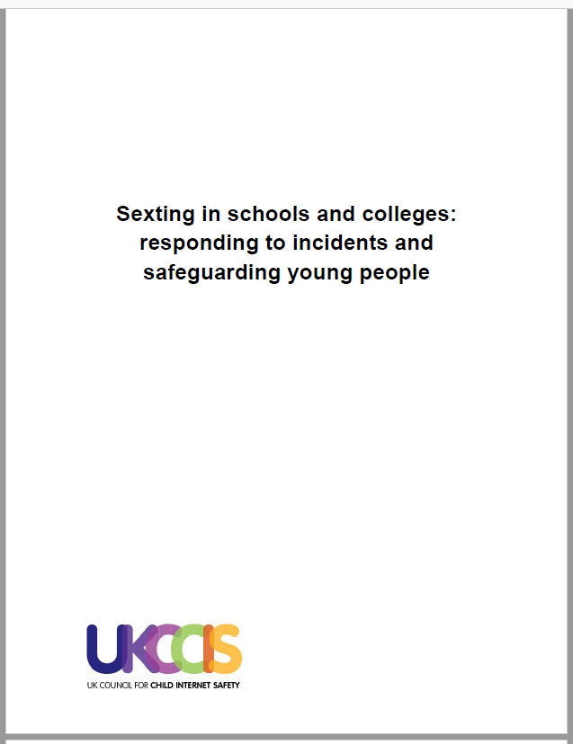
Sexting: New Guidance (UKCCIS)
https://www.gov.uk/government/uploads/system/uploads/attachment_data/file/545997/Sexting_in_schools_and_colleges_UKCCIS__4_.pdf

Slide 21
Sexting
90% of 16-24 year olds and 69% of 12-15 year olds own a smartphone, giving them the ability to quickly and easily create and share photos and videos.
A 2016 NSPCC / Office of the Children’s Commissioner England study found that just over one in ten boys and girls (13%) had taken topless pictures of themselves (around one in four of those were girls) and 3% had taken fully naked pictures. Of those who had taken sexual images, 55% had shared them with others. 31% of this group had also shared the image with someone that they did not know.
Research conducted by ‘The Key’ found that 61% of its secondary school head teacher members reported ‘sexting’ as a concern. This placed it higher than drugs, obesity and offline bullying in terms of frequency of reporting as a concern.

Slide 22
Sexting: New Guidance (UKCCIS)
This advice is for designated safeguarding leads (DSL’s), their deputies, headteachers and senior leadership teams in schools and educational establishments
What does this advice cover?
Responding to disclosures
Handling devices and imagery
Risk assessing situations
Involving other agencies, including escalation to the police and children’s social care
Recording incidents
Involving parents
Preventative education

Slide 23
Definition of ‘Sexting’
(Youth Produced Sexual Imagery)
Youth produced sexual imagery best describes the practice because: ‘youth produced’ includes young people sharing images that they, or another young person, have created of themselves.
‘Sexual’ is clearer than ‘indecent.’ A judgement of whether something is ‘decent’ is both a value judgement and dependent on context.
‘Imagery’ covers both still photos and moving videos (and this is what is meant by reference to imagery throughout the document).
The types of incidents which this advice covers are:
A person under the age of 18 creates and shares sexual imagery of themselves with a peer under the age of 18.
A person under the age of 18 shares sexual imagery created by another person under the age of 18 with a peer under the age of 18 or an adult.
A person under the age of 18 is in possession of sexual imagery created by another person under the age of 18.
***Youth Produced Sexual Imagery (clarifying specifics on images not just sexually explicit messages)

Slide 24
Management of Incident's
The incident should be referred to the DSL as soon as possible.
The DSL should hold an initial review meeting with appropriate school staff.
There should be subsequent interviews with the young people involved (if
appropriate).
Parents should be informed at an early stage and involved in the process unless there is good reason to believe that involving parents would put the young person at risk of harm.
At any point in the process if there is a concern a young person has been
harmed or is at risk of harm a referral should be made to children’s social care
and/or the police immediately.

Slide 25
Assessing the Risks
When assessing the risks the following should be considered:
Why was the imagery shared?
Was the young person coerced or put under pressure to produce the imagery?
Who has shared the imagery? Where has the imagery been shared? Was it shared and received with the knowledge of the pupil in the imagery?
Are there any adults involved in the sharing of the imagery?
What is the impact on the young people involved?
Do the young people involved have additional vulnerabilities?
Does the young person understand consent?
Has the young person taken part in this kind of activity before?
***DSL’s should always use their professional judgement in conjunction with their colleagues to assess incidents.
Sexting in Schools and Colleges: Responding to incidents and safeguarding young people (2016)

Slide 26
Outcome 21
Every ‘crime’ recorded on police systems has to be assigned an outcome from a predefined list of outcome codes. As of January 2016 the Home Office launched a new outcome code (outcome 21) to help formalise the discretion available to the police when handling crimes such as youth produced sexual imagery. (Sexting)
Outcome 21 states: Further investigation, resulting from the crime report, which could provide evidence sufficient to support formal action being taken against the suspect is not in the public interest. This is a police decision.
This means that even though a young person has broken the law and the police could provide evidence that they have done so, the police can record that they chose not to take further action as it was not in the public interest.
Consequently, schools and colleges can be confident that the police have discretion to respond appropriately in cases of youth produced sexual imagery and to record incidents in a way which should not have a long term negative impact on young people.

Slide 27
Searching, Screening and Confiscation (DFE)
The Education Act 2011 amended the power in the Education Act 1996 to provide that when an electronic device, such as a mobile phone, has been seized, a teacher who has been formally authorised by the headteacher can examine data or files, and delete these, where there is good reason to do so. This power applies to all schools and there is no need to have parental consent to search through a young person’s mobile phone.
If during a search a teacher finds material which concerns them and they reasonably suspect the material has been or could be used to cause harm or commit an offence, they can decide whether they should delete the material or retain it as evidence of a criminal offence or a breach of school discipline. They can also decide whether the material is of such seriousness that the police need to be involved.
See Searching, Screening and Confiscation Advice (DFE) for further details.

Slide 28
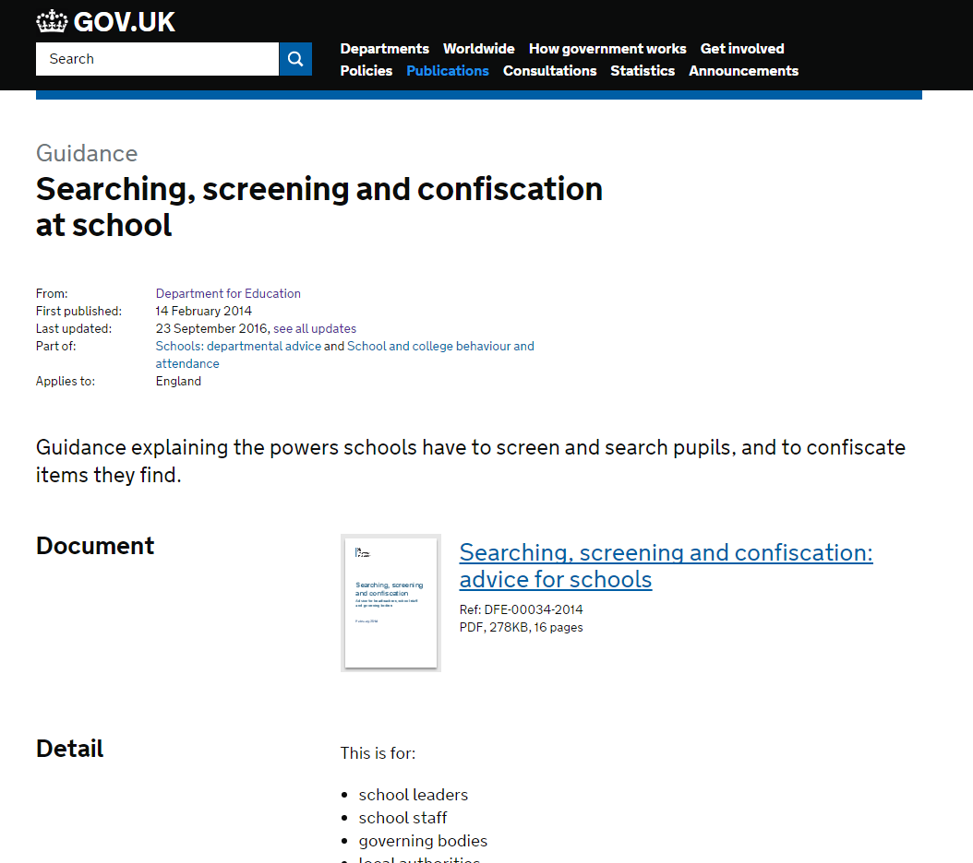
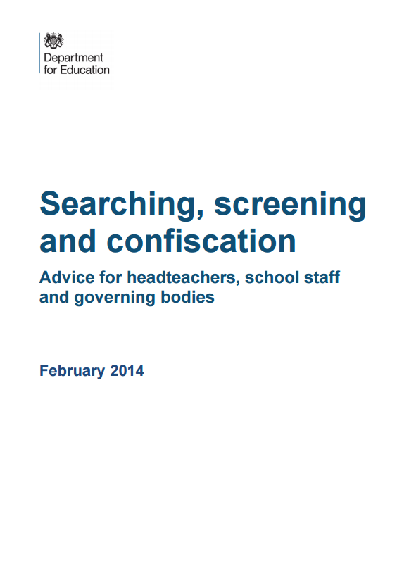
Searching, Screening & Confiscation
Updated on
23 September 2016 to include a link to the UK Council for Child Internet Safety’s advice on responding to ‘sexting in schools and colleges’ (P13).

Slide 29
Serious Case Review - Child J
Child J committed suicide in January 2013, following ongoing trauma from a sexual assault incident in 2011
Child J became bulimic following the incident and disclosed her bulimia in November 2012, she then self harmed through overdose and was referred to CAMHS
Child J Self harmed through cutting after drinking at a party in December 2012. Friends informed professionals about her suicide notes
Friends informed professionals that Child J planned to kill herself after Christmas
Child J seen by CAMHS on 3rd January, committed suicide on 4th January 2013

Slide 30


Slide 31
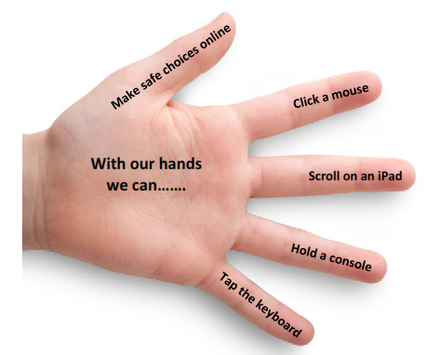






Slide 32






Help (always look for adults to help if you are on the internet)
Ask (questions from safe adults to help you explore)
Never (use things on the internet that you are not supposed to)
Do (have fun exploring on exciting websites)
Safety (always make safe choices and protect yourself)

Slide 33
What Can We Do In Our Setting
To Prevent Those Risks?
Cyber safety awareness/agreements.
Meaningful discussion of risk and resilience - age appropriately.
Discussion about what is online and what is reality.
Challenge children’s perceptions around their behaviour and consequences and the difference between school and home life.
Access to other young people who can talk about impact rather than other adults.
Staff who are knowledgeable about internet safety.
Acting upon informal conversation.
Challenging children and parents allowing children to access inappropriate sites.

Slide 34
What Can We Do At Home
To Prevent Those Risks?
Supervise
Parental controls
Discussion
Agreed timings for access
Monitor activity
Work together with education setting to ensure consistent messages are applied
Use sites such as CEOP and ‘thinkuknow’ to keep up to date with information

Slide 35
Consider
What do we do here?
How do we know the messages we put in place for children are carried out at home?
Would children share with us if they were concerned about themselves or others?
Are children given opportunities to speak and be heard through the curriculum?

Slide 36
Breck’s Story
14 year old boy, murdered at a flat in Essex on 17.02.2014 by 18 year old Lewis Daynes.
Breck had mainly online contact with Lewis through an ‘exclusive’ six person online gaming club via a youth group at church.
Lewis groomed Breck through manipulation of common traits and told many lies such as donating millions in bit coins to Syrian Rebels and getting Breck a £100,000 a year job so he didn’t have to continue at school.
Breck’s mother staged an intervention with Breck and other parents due to Lewis’ concerning behaviour and changes to Breck’s ideology. Requesting information about Lewis from the police.

Slide 37
Breck’s Story
Breck’s mother limited all online access and the relationship appeared to sever.
However, Lewis made secret contact by sending Breck his own phone.
Lewis arranged to meet Breck two weeks in advance, booking a taxi to get him to his flat, telling Breck he wanted to hand over his business to him and to bring all of his computer equipment.
Lewis calmly rang the police to advise he had killed Breck in his flat, after posting online images of Breck’s dead body, received by his family before they were officially notified by the police.
When police arrived there was evidence of bound duck tape, and several items of computer equipment and hardrive was submerged under water.

Slide 38
What Went Wrong?
Breck’s friends didn’t recognise his vulnerability when they realised Lewis was a ‘fake’.
Lack of knowledge of how drawn in Breck was becoming.
Lack of police information shared despite mother’s contact.
Intervention from parents to other parents rather than the young people involved.
Belief that online access is less risky.

Slide 39
Case study 1
Sarah and Jennifer are best friends. They like to ‘snap chat’ each other after school. Yesterday Sarah took a photo of Jennifer and filtered it on an app to make Jennifer look like a pig. Initially Jennifer thought it was funny but now Sarah has sent it to everyone in class and put it on facebook. When Jennifer told Sarah she was upset, Sarah laughed it off and told her not to be so sensitive. Jennifer would not have told anyone but another friend’s parent informed her mother. As parents are now involved, Sarah has sent Jennifer a string of unpleasant messages including that she doesn’t want to be her friend anymore. Jennifer’s parents are furious and have come into school seeking further intervention. Sarah’s parents although punishing her are very aggressive and defensive when you have addressed issues with them before.

Slide 40
Consider
How would you address this with the children?
How would you address this with the parents?
How could you use the curriculum to support you?
What would be your next steps following an incident like this?
What, if anything, made Jennifer more vulnerable?
If Sarah is a typically well behaved pupil, why did she behave as she did?

Slide 41
How Can We Identify Risk/Vulnerability?
Consider in a group of young people who may be the most vulnerable.
Encourage young people to talk about what they are doing online and the risks involved.
Encourage young people to share if they are concerned by someone’s behaviour online or about a friend’s safety.
Encourage young people to talk about the discussions they may have online and the viewpoints they may hear.
Encourage young people to distinguish between what is online and what is reality (have ‘real’ time more than ‘online’ time)

Slide 42
Case Study 2
Paul is 11 and has two younger siblings aged 8 and 4. Paul has been regularly using the social network site ‘Facebook’. He tells you in school that he has made some new friends on the site including a boy called John who is also ‘11’ and attends another local school. He also says he has been on Facebook whilst in school. Paul also tells you that the boys have made arrangements to meet up at the local field on Saturday for a game of football and John has made arrangements for some other boys to join the game. Paul hasn’t told his parents as ‘they are too busy working’. Paul’s parents are professional parents. You have had no previous concerns regarding the family.

Slide 43
Safeguarding Children
Vulnerable Adults
Safe People
Our responsibilities to Safeguarding in schools and settings
Safe Premises & Places
Safe Children

Slide 44
Consider the ‘bubbles’ of safeguarding
What is the impact of this case on your school’s safeguarding arrangements?
Think of each of the bubbles in turn, how does it effect each area?
What is the impact on Paul and School?
What needs to change to effect the outcome for Paul?

Slide 45

The ‘Hand Model’
Recognise the most vulnerable
Talk Openly
Share other viewpoints
Have ‘real’ time
Encourage peer disclosure

Slide 46
Making the Difference
Think family
Notice behaviours
Listen and give opportunities
Don’t ignore hearsay or voices of other children
Help young people to consider impact
Support young people to share information

Slide 47
Safeguarding Children
Vulnerable Adults
Safe People
Our responsibilities to Safeguarding in schools and settings
Safe Premises & Places
Safe children

Slide 48
Safeguarding is Everyone’s Business
Focus on the Voice of the Child

